Slide 1
实战中的软件工程
构建之法 – 现代软件工程 第 7 章
邹欣
2018

Slide 2
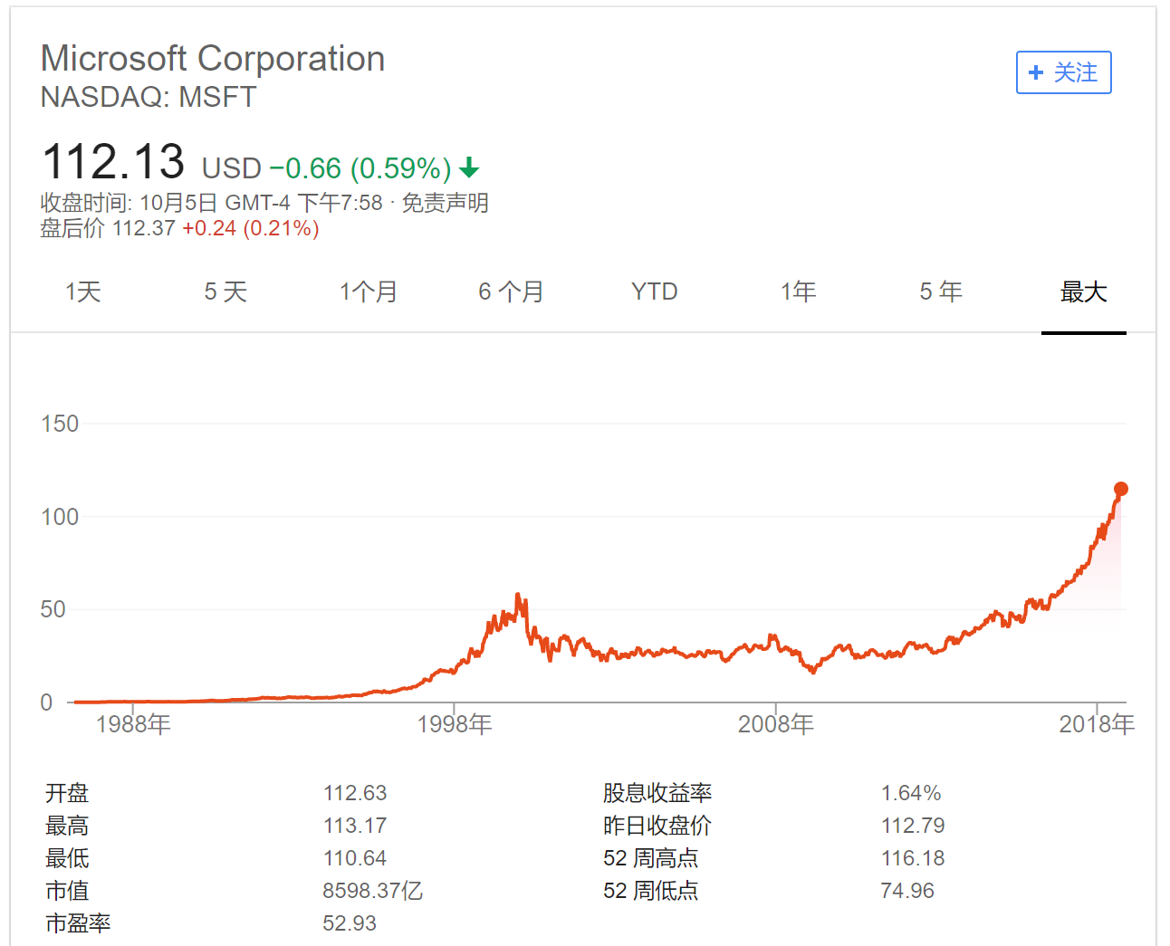
微软如何做项目管理（传说和个人经历）
牛仔式的开发 Cowboy
用简单工具：Excel，Notepad
专用工具：Raid
用聊天工具来管理行么：BBS
通用的项目管理工具：MS Project
转回专用工具：Product Studio
开放的工具：VS Team Foundation
继续开放： git + TFS

Slide 3
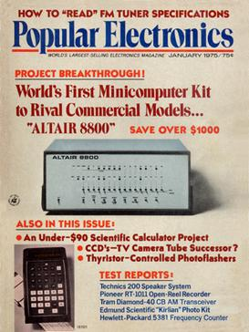
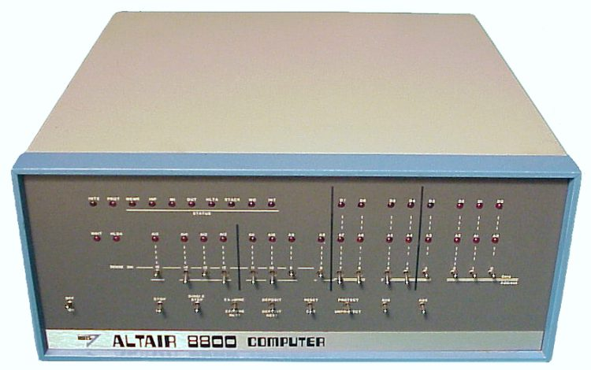
Cowboy
Just write code!
Depends on personal technical strength
Story — First Basic interpreter
Cowboy style （牛仔风格）
Individual excellence
Hard working

Slide 4

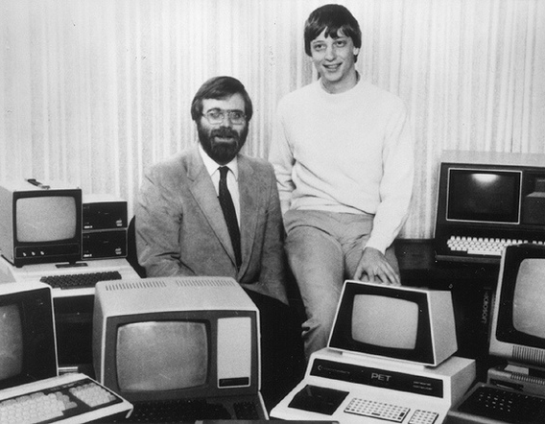
如何克服困难
时间紧：睡在机房里面
任务重，无实体机器：
分工：Paul 写模拟器， Bill 在模拟器上写Basic 的解释器
突发情况：发现没有写解释器loader
在飞机降落的过程中写出来
结果：
第一次在实体机器上演示就成功
Notes:
https://www.youtube.com/watch?v=pqAg0GJLPGk

Slide 5
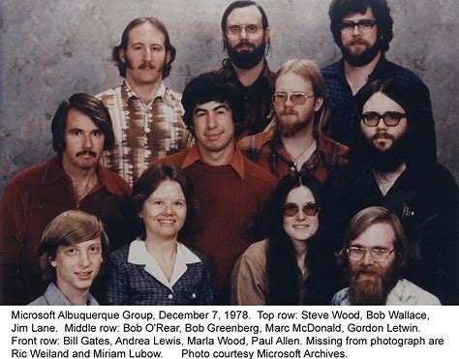
有奖竞猜(1)
一个员工对BillG 说 :
俺上午10点钟来上班，晚上10点才离开。累。。。
BillG 的回答是：
同志们辛苦了！
洗洗睡了吧！
你不是一个人在战斗…
怎么搞的，只工作了半天？

Slide 6


Excel, NotePad，Whiteboard
Excel and other simple tools
Easy, everybody has it and can use right away
Problems：
Hard to store and retrieve history
Cannot handle large teams
Lack of support for sharing and multiple editing

Slide 7
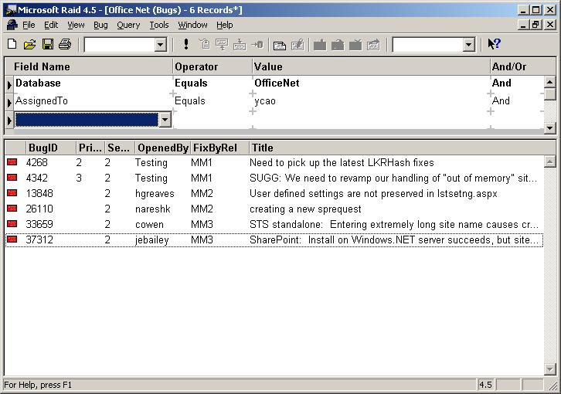

Raid — bug killer

Slide 8
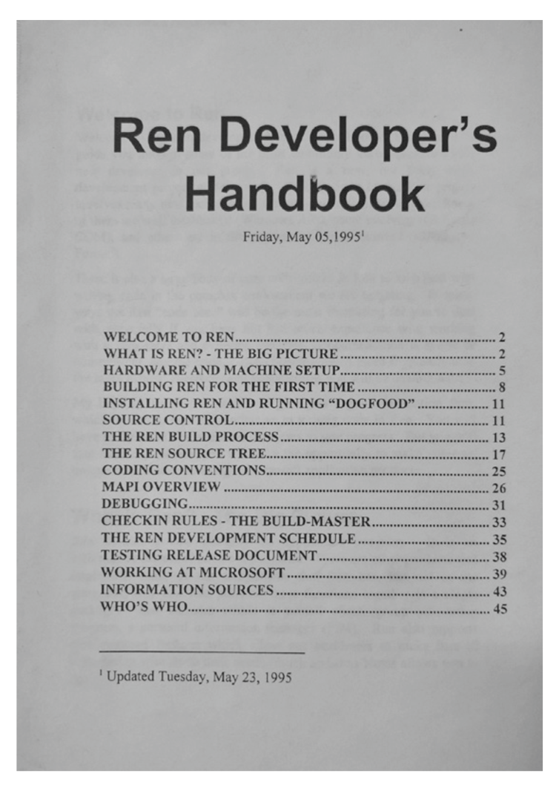
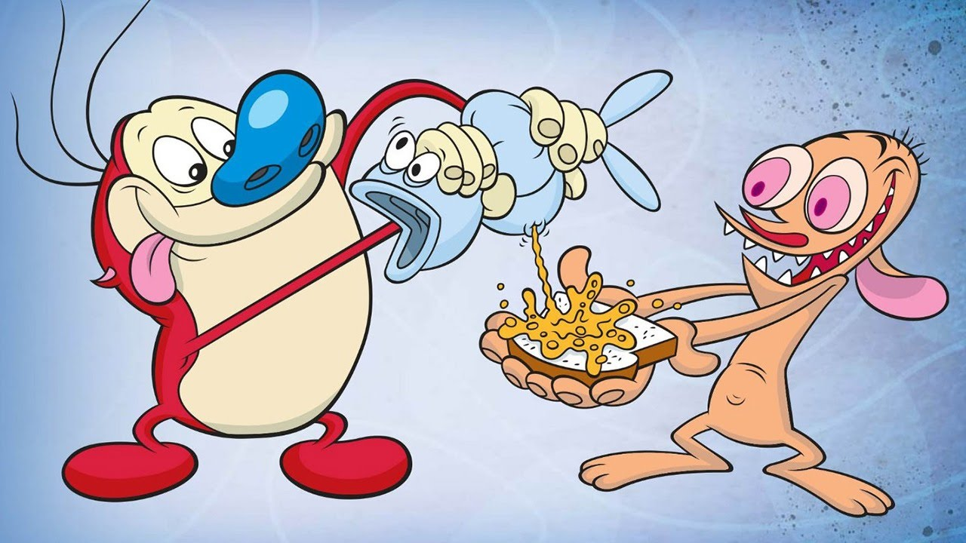
Outlook 团队 - dev入门手册

Slide 9
Raid
Everything is “bug”
You can create/edit/query bugs
Bug fields：
Title/priority/severity/assigned to
A field called “issue type”
Bug, suggestion，localization issue, performance
Different Issue Type implies different work flow
Raid as part of MS culture —“raid me a bug”.
Manage windows 95/2000, office 97, millions of records

Slide 10
BBS （Microsoft Exchange Public Folder）
我们平时就在BBS 上活动，能否也用BBS 来管理软件开发呢？
Outlook 98: solve the sharing problem
Part of “dogfood exchange”
Fast definition of exchange forms, and easy sharing
Clear roles and responsibilities
Can sort by key fields and show simple project status
issues：
No history
No easy query language
Almost like today’s SharePoint list, or 水木BBS
Lesson – let each team decide what’s best for the team.

Slide 11
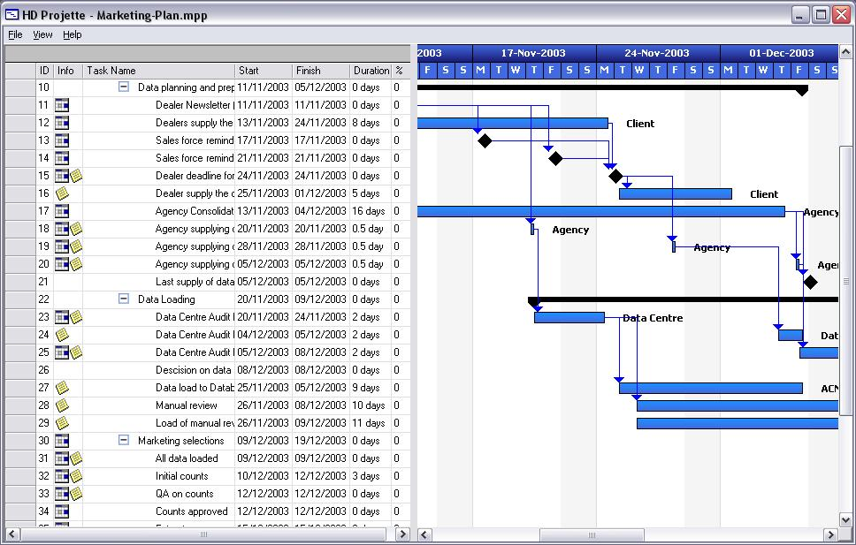
Microsoft Project
Why can’t we use MS Project to manage our software project?
Great in high level planning
Huge charts and tables in the hall way

Slide 12
Microsoft Project
Troubles
Sharing
It assumes everybody finishes one task then start the next one.
Dependencies become a mess （复杂的依赖关系）
How to assign on task to another person, while keeping the previous history?
How to show the status of the whole team?

Slide 13
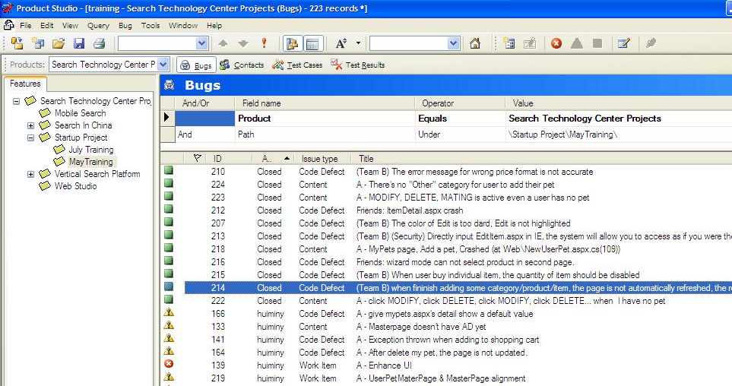
Product Studio

Slide 14
Product Studio
We used in Outlook XP – Outlook 2007
Provides Object Model for add-in
Replaces Raid
Product Studio supports more types
bugs/TestCases/TestResults.
Planning to support “task management”

Slide 15
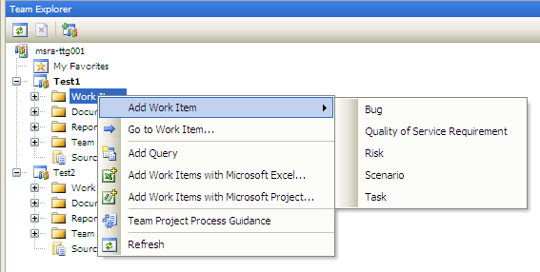
Team Foundation Server
Work item = all things we need to do

Slide 16
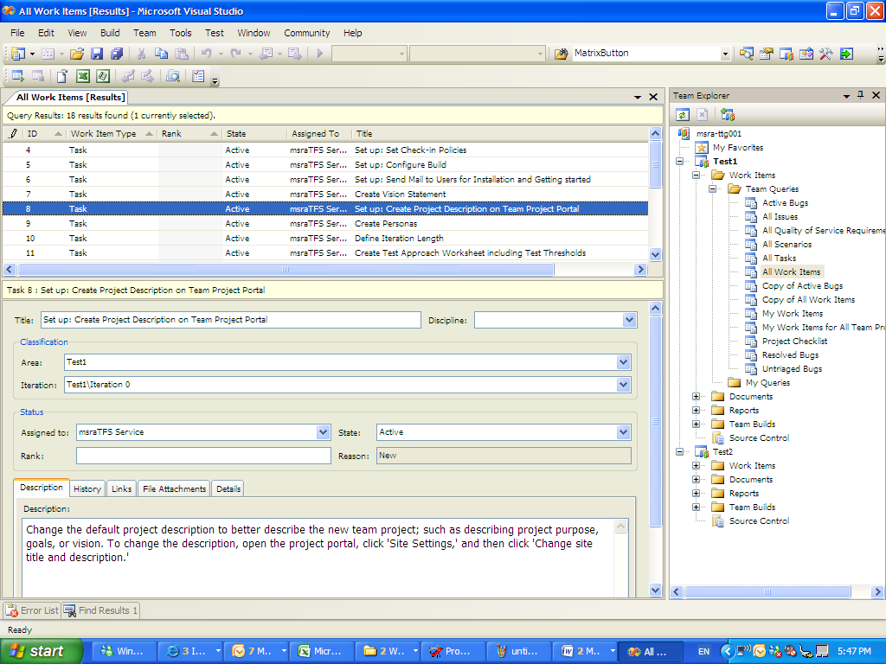
TFS

Slide 17
TFS work item types
Work item types
Task
Bug
Scenario
Risk
Quality of Service Requirement
Reference name
The permanent name for a field
Company.domain.name

Slide 18
Strength of TFS
Flexible
Team size 5 ~ 2000
Support different process (MSF Agile, CMMI)
Integrated tool
Work item tracking / source control / build / reporting
public Web Service API
Work with 3rd party apps
public programming API
You can design your own add-in
Web interface，and multiple clients

Slide 19
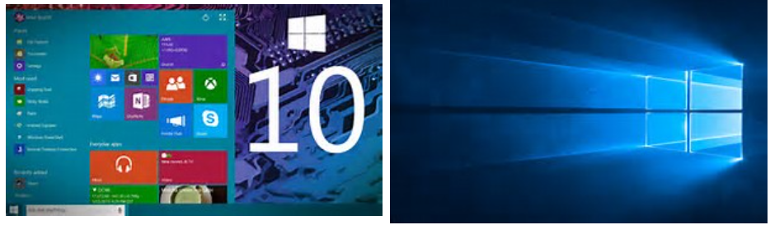
TFS & Win10
Most of current MS projects are managed by TFS
People: 30,000
Source code: 100G
Location: 6 different time zones

Slide 20
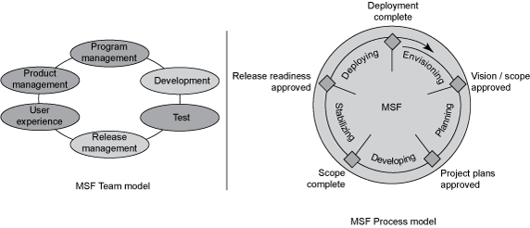
Roles in Microsoft Teams
Dev
Test
PM

Slide 21
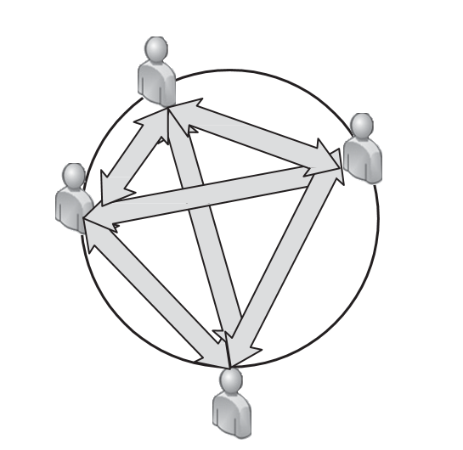
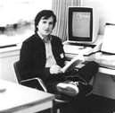
History of PM in Microsoft
As the team grows, communication becomes a problem
O(n^2)
Keep adding programmers into a team is NOT going to work
Charles Simonyi has an idea
Notes:
From Joel on Software

Slide 22
Original idea of PM
Program Manager
Master Programmer vs. Slave Programmer
Master Programmer (Program Manager)
Write high level code
Slave/Junior Programmer
Write detail implementation code
Works for a PM
“programmer’s apprentice” - similar idea
But, nobody wanted to be a “slave”, or an “apprentice”

Slide 23
A bunch of busy engineers
Software development was getting so complicated that
None of the programmers had the time to figure out how to make software that was either usable or useful.
The marketing team was ranting and raving about customer needs and nobody had time to talk to them or translate their MBA-speak into actual features.
Product design involves a lot of work:
talking to users,
running usability tests,
reviewing competitive products,
and thinking hard about how to make things easier,
most programmers just didn’t have the time (nor were they particularly good at it).

Slide 24
Turn the idea around
Jabe Blumenthal (1984, first PM)
PM
Do everything besides coding and testing
PM would own the design and the spec for products.
PM has similar career path as dev/test
PM->PM II -> Senior PM -> Principal PM ->…
PM->PM lead -> PM Manager (Group PM) ->Director of PM -> VP in charge of PM

Slide 25
Role of PM - Money
Role of PM
Gather requirements
Design UI, Write spec
Coordinate marketing, documentation, testing, localization
Lead the team to reach decision (as money to the society)
PM: focus on the big picture, the balance of Time/Resource/Feature
Dev/test/etc: focus on individual technical issues

Slide 26
Project Manager vs. Program Manager
Proj. Manager | Prog. Manager
Leads a team of subordinates to work on a project | Work with peers on feature(s)
Usually the single person representing the project to stake holders and customer | many PMs working inside a team
Has final say about features and other decisions | Work with others to reach a decision
Also focus on People management | Focus only on technical issues

Slide 27
有奖竞猜(2)
What’s Microsoft Dev : Test ratio in 1982?

Slide 28
Tools + methodology
Ad hoc ->General -> specialized
Excel -> Raid -> Project ->Product Studio -> TFS
Methodology evolves
All devs in early years
Shared test team to specialized test team
dev: test 20:1 to 1:1
PM (1984)
Feature team
pm + dev + test
Focus on security and process
MSF 4.0
Agile
MSF for CMMI

Slide 29
MSF & other theories
MSF & CMM
Should we use Capability Maturity Model to measure MS process?
MSF & Six Sigma
A six sigma process is one in which 99.99966% of all opportunities to produce some feature of a part are statistically expected to be free of defects (3.4 defective features / million opportunities)
Should we treat software development as hardware manufacture?
MVP: Minimum Viable Product
MBP: Maximum Beautiful Product

Slide 30
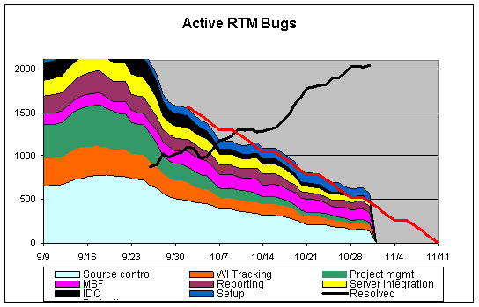
Drive for result – death march
Stabilization
Drive to ZBB

Slide 31
2008 — later
Agile Process
SCRUM, Burn Down Chart
Continuous Improvement
Quick feedback and fix from users

Slide 32
新做法
和用户社区有紧密的联系，要发布的功能都事先通气
在公司内部采用了Stack Overflow 企业版，大家在内部的Stack Overﬂow 进行技术交 流
TFS 也和Git 无缝集成，微软的默认源代码管理工具采用了Git 为了让Git 能处理 庞大的代码库，TFS 团队还进行了几次技术改造，并且把这个项目开源共享。
自组织的团队: 每个大的里程碑结束后，所有的团队成员都可以自己选择下一个项目
这时候，项目的领头人，通常是研发组长和PM，就要一起极力向大家兜售自己项目 的意义，声称在他们领导下的团队将是多么有意思，等等。数据显示，八成的团队成 员留在原来的团队，二成换组，这对于团队技能的持续性、开拓新机会、带来新鲜血液， 都是很好的平衡。

Slide 33
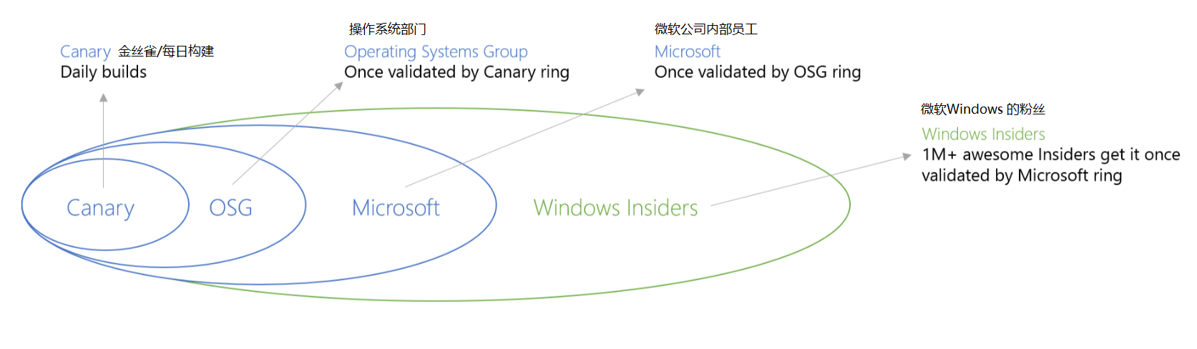
Windows 10 Release
Daily Build & Test: Canary
Depends on quality, push to OSG/Microsoft/Windows-Insiders

Slide 34
Windows 团队取消了专职测试

Slide 35
Summary
Technology and culture shapes the way we manage project
Technology
Whiteboard, excel, notepad, client/server, managed code, web…
Culture
Result-driven
Hard working
Dogfood
Let individual team make decision
Postmortem, keep learning
Respect the rules in software engineering

Slide 36
Different types of “Building”
Build To Learn：
开发软件，构建系统的目的是做进一步的试验，试图发现客观规律或某个试验方法的优点与缺点。这些项目经常是科研论文的基础工作。
Build To Show：
为了突出地展现某个技术的作用，开发一些演示为目的的软件，这些项目很吸引眼球，经常获得新闻报道，但是功能未必全面或实用。
Build To Serve：
为了服务一定范围的目标用户而构建的工具等，有时以公开的SDK 形式发布，让别的研发人员使用。
Build To Win：
以在市场上赢得用户为目标而构建的软件。这也是种种科学发现，技术突破最好的试金石。所有以营利为目的的公司和团队都在为此努力。

Slide 37
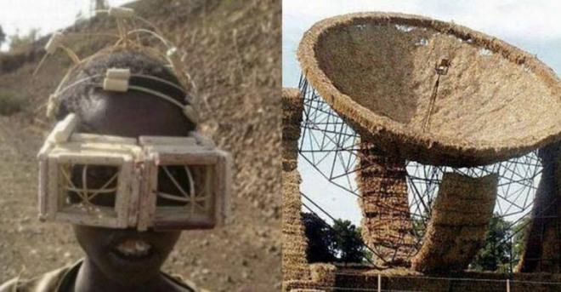
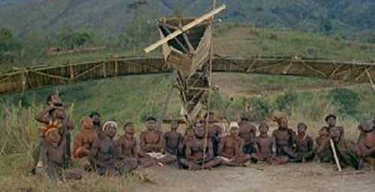
Cargo Cult
二战时美军在太平洋某个小岛修 建了机场，岛上的土著们看到士兵头戴钢盔，身背步话机，嘴里不停地叽里咕噜。 然后，神奇的大鸟从天而降，士兵们从鸟肚子里拉出一箱箱货物，土著们也偶尔能 分到一些口香糖、香烟等新鲜玩意。战后美军撤了，土著们开始举行庄严的仪式， 他们把椰子壳扣在脑瓜上，身上绑着树枝冒充天线，模仿美军的样子，向空中喊叫， 希望神奇的大鸟能和以前一样从天而降。然而大鸟终究没有来，于是他们用椰子树 和野花扎了一个色彩斑斓的飞机模型来模拟大鸟的降落。
货船崇拜（Cargo Cult），就是试图以形似而神不似的努力， 去期望奇迹的发生。
Notes:
https://www.newhistorian.com/melanesian-cargo-cults-consumerism/8821/

Slide 38
避免 “形似而神不似”
做好软件项目，离不开人、技术、工具和方法。什么是软件开发的本质？
文盲戴上度数合适的眼镜，就能识字么？
“识字”的本质是什么？
什么样的条件能导致装 满货物的飞机降落到一个小岛上？
这个事情发生的本质原因是什么？ 是用椰子壳 做的头盔么？如果把头盔换成正牌的美军头盔，“ 飞机到来”的成功率会增加么？
团队A 用简单的看板方法，把写有任务内容的小贴纸贴在墙上；团队B 用大型项 目管理软件，把任务状态存储在数据库中， 并通过算法画出任务变化的曲线。仅此区别，能推导出这两个团队的成功率的区别么？

Slide 39



References

Slide 40
练习和讨论
http://www.cnblogs.com/xinz/p/3854387.html

Slide 41
appendix

